Slide 1


Hope to Skills
Lecture# 16
Irfan Malik, Dr. Sheraz Naseer

Slide 2
Slide credits:
Irfan Malik, Dr. Sheraz Naseer

Slide 3
Agenda
Data Science processes

Slide 4
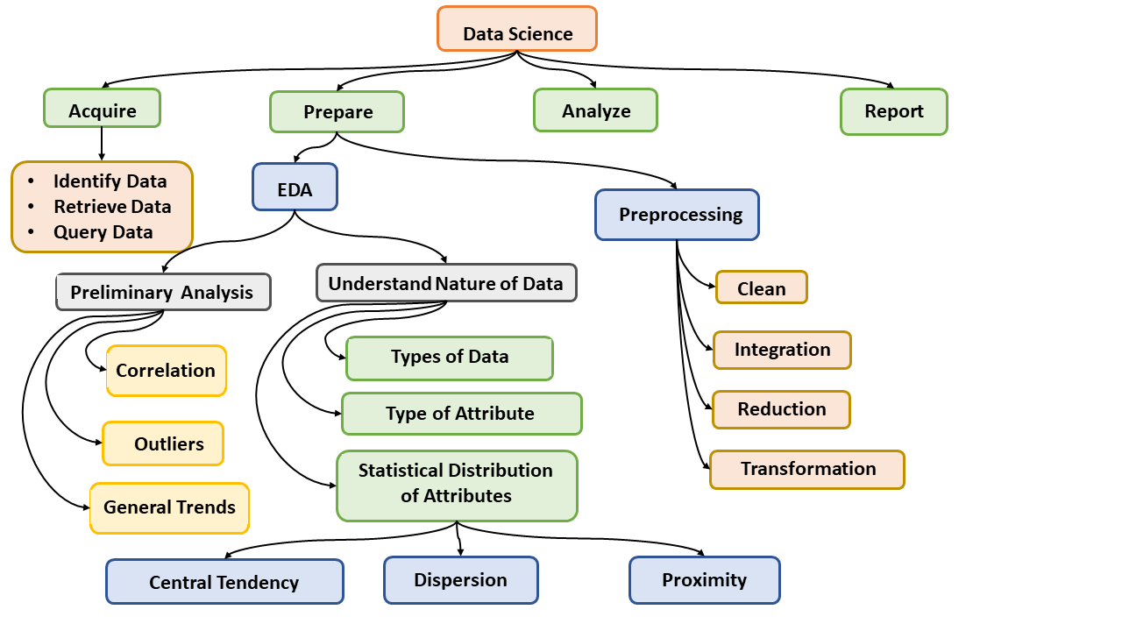
Data Science Processes - I

Slide 5
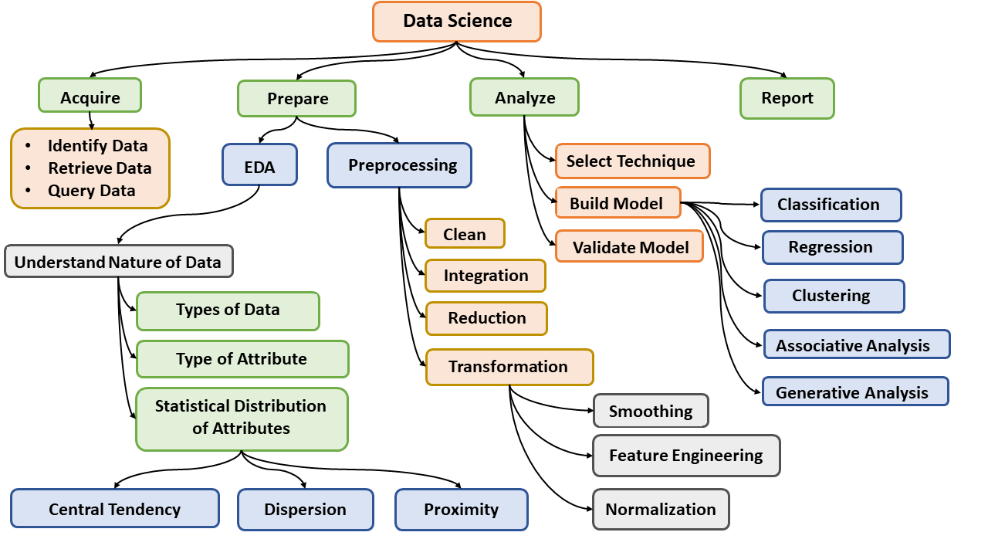
Data Science Processes - II

Slide 6
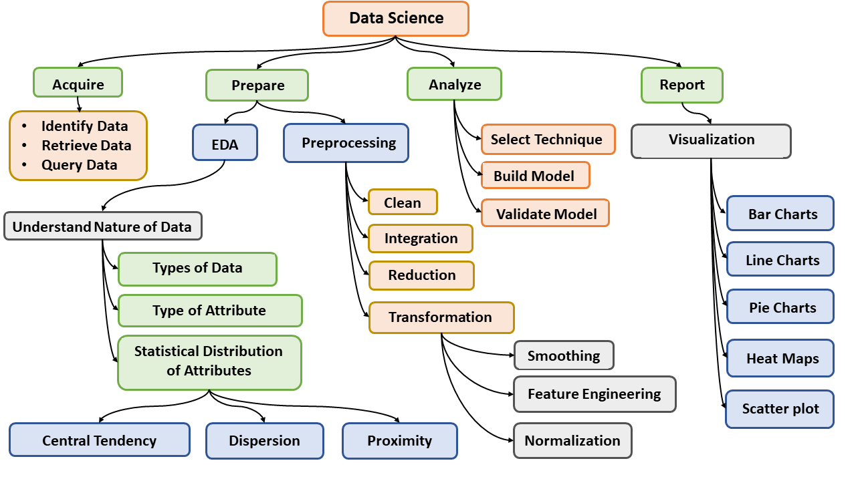
Data Science Processes - III

Slide 7
Data Skewness:
Data skewness is an uneven distribution of data within a dataset. It occurs when certain values or ranges of values appear more frequently than others. This skewness can occur in various dimensions of the dataset, such as columns, partitions, or even individual files.

Slide 8
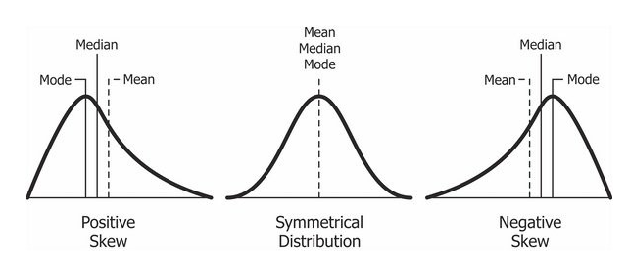
Distributions

Slide 9
Positive Skewness: If the mode is smaller than the mean, the data is positively skewed.
Negative Skewness: If the mean is smaller than the mode, the data is negatively skewed.
Symmetrical Distribution: Mean, median, and mode are all equal; distribution is balanced.

Slide 10
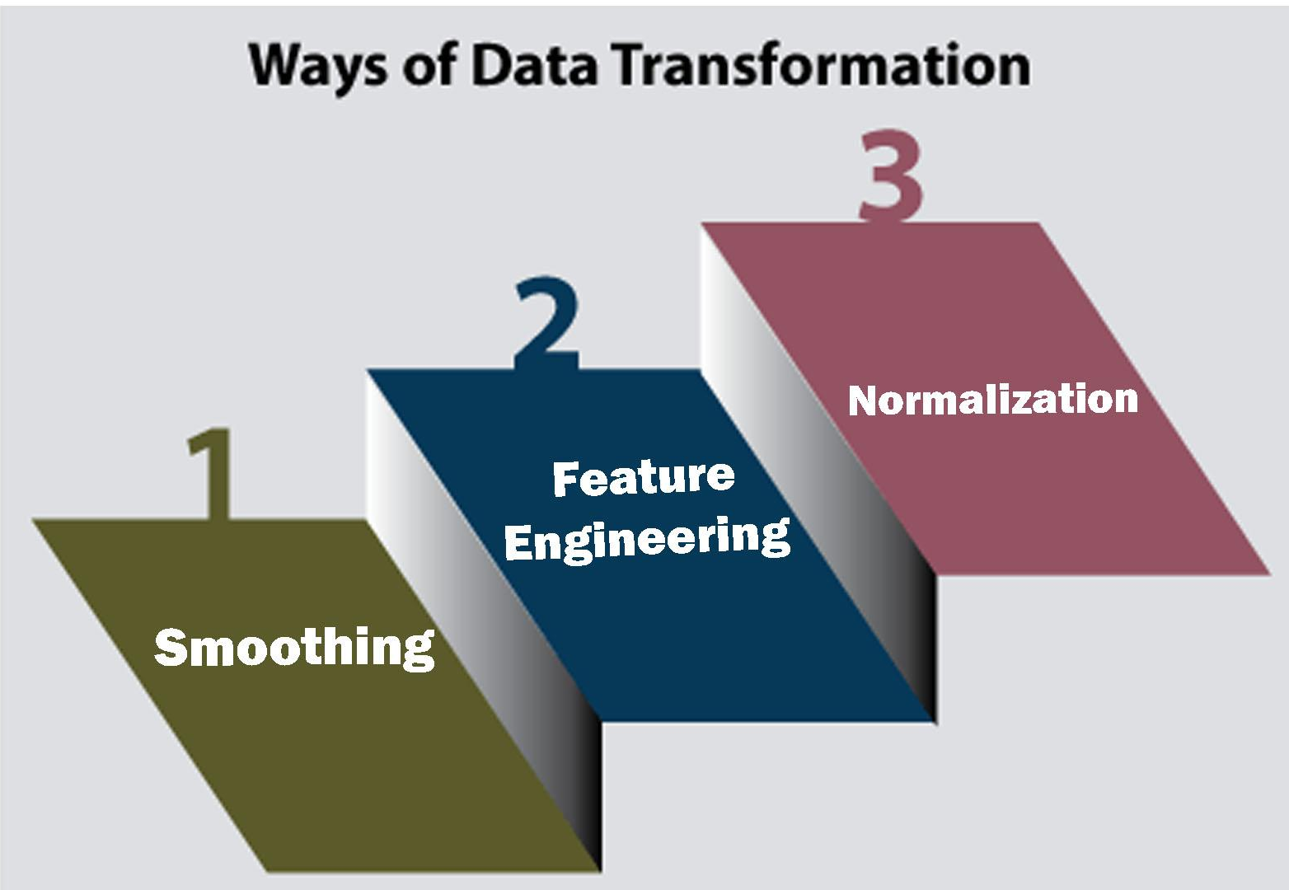
Data Transformation:
Data transformation is the process of converting, cleansing, and structuring data into a usable format that can be analyzed to support decision making processes, and to propel the growth of an organization.

Slide 11
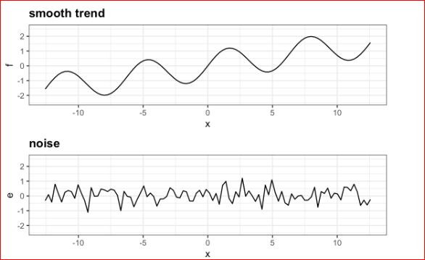
Smoothing:
Smoothing in data preprocessing refers to a set of techniques used to reduce noise and fluctuations in data while preserving important underlying trends and patterns. It is a crucial step in preparing data for analysis and modeling, particularly when dealing with noisy or uneven data points.

Slide 12
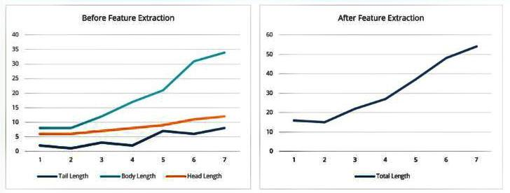
Feature Engineering:
Feature engineering is an essential step in the data science process that involves creating and transforming raw data into features suitable for building machine learning models.

Slide 13
Data Normalization:
Normalization is a data preprocessing technique that transforms data values to a common scale or distribution of values. It can include adjusting the scale of values to a similar metric or adjusting the time scales to be able to compare like periods.

Slide 14
Scaling:
Min Max Scaling
Z-score Scaling

Slide 15
Data Visualization Charts

Slide 16
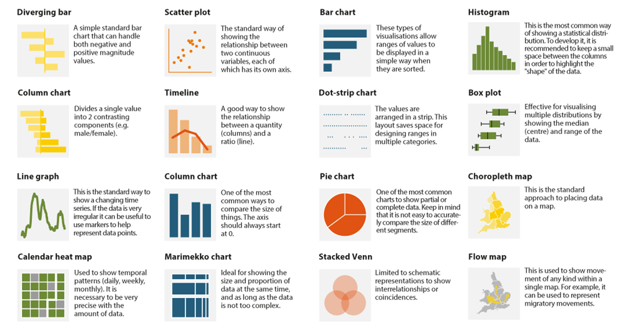

Slide 17
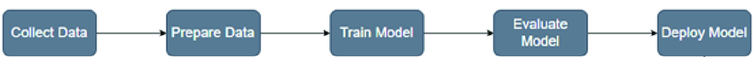
Model Building:
Model building involves the process of selecting and training a machine learning model using a dataset to learn patterns and relationships within the data. This typically includes steps such as preprocessing the data, selecting an appropriate algorithm, splitting the data into training and validation sets, training the model on the training set, and evaluating its performance on the validation set.

Slide 18
Model Validation:
Model validation is a machine learning (ML) process that assesses how well a model can produce predictions or outputs. It's important to validate models before deployment to ensure they're accurate and reliable.

Slide 19
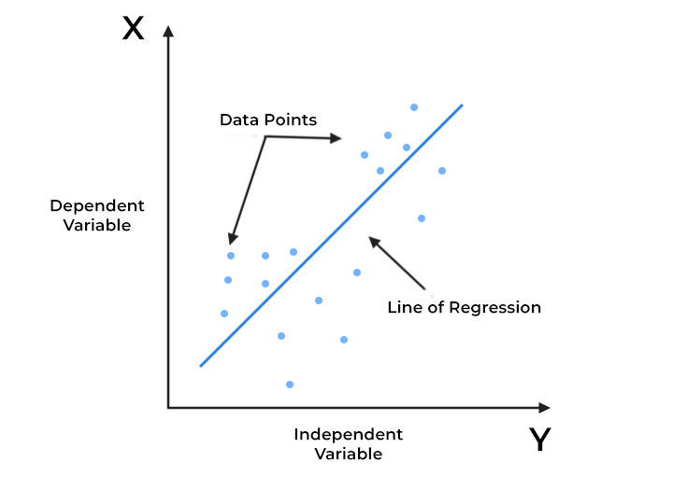
Linear Regression
Linear regression is a supervised machine learning algorithm used for predicting a continuous output (dependent variable) based on one or more input features (independent variables).

Slide 20
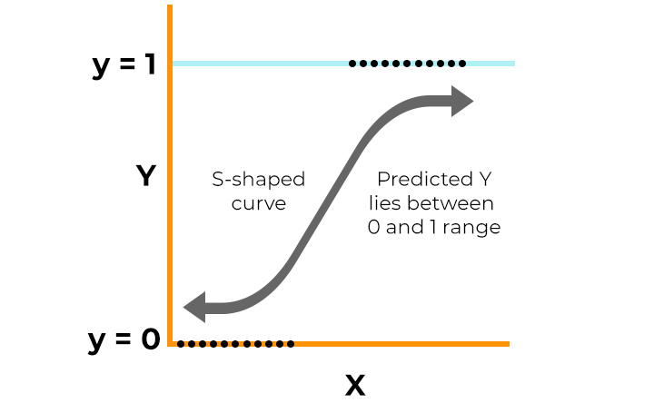
Logistic Regression
Logistic regression is a supervised machine learning algorithm that accomplishes binary classification tasks by predicting the probability of an outcome, event, or observation.

